Slide 1
CSE1142 – Characters and Strings in C
Adapted from Dr. Sanem Arslan Yılmaz.
Some of the slides are from: CMPE150 – Boğaziçi University, Deitel & Associates.

Slide 2
Agenda
Characters
Strings
  Definitions & Syntax
  Initialization
  Index and bounds
Character-Handling Library
String Functions
String-Conversion Functions
Standard Input/Output Library Functions
Search Functions of the String-Handling Library
Examples

Slide 3
Characters
Building blocks of source programs.
  Every program is composed of a sequence of meaningfully grouped characters.
Character constant
  An int value represented as a character in single quotes
  'z' represents the integer value of z

Slide 4
What is a String?
A string is actually a character array.
  You can use it like a regular array of characters.
  However, it has also some unique features that make string processing easy.
A string may include letters, digits and various special characters such as +, -, *, / and $.

Slide 5
What You Should Keep in Mind
Anything written in double quotes (" ") is a string.
The end of a string is always marked with the invisible null character '\0'.
  We say "a string is always null-terminated."
  All string functions depend on this null character. If you ignore the null character, everything will fail.
  You have to take into account that null character also consumes one byte.
Strings should be treated gently. Failure to abide with the rules results in disaster.

Slide 6
Strings
So, the idea is simple: Obey the following simple rules:
  When you define the string variable, do not forget to add one byte for the null character.
  All string functions depend on the null character so do not mess around with the null character.
    Anything after the null character will be ignored.
    Anything up to the null character will be considered.

Slide 7
Initializing Strings
Instead of initializing the elements of a string one-by-one, you can initialize it using a string.
  A character array or a variable of type char * can be initialized with a string in a definition.
Example:
  char st[] = "JAVA&C";
  char st[] = {'J','A','V','A','&','C', '\0'};
  char *st = "JAVA&C";
Notes:
- Explain and run C42_05_printCharacters.c.

Slide 8
Inputting Strings
A string can be stored in an array using scanf.
For example, the following statement stores a string in character array word[20]:
    scanf("%s", word);
    The string entered by the user is stored in word[].
    Because a string is a pointer, we do not need &.
    Remember to leave room in the array for '\0’
Use scanf("%19s", word);
    scanf reads a maximum of 19 characters
    saves the last character for the string’s terminating null character
    prevents scanf from writing characters into memory beyond the end of word.

Slide 9
Character-Handling Library
The character-handling library (<ctype.h>)
  includes several functions that perform useful tests and manipulations of character data.
Each function receives an unsigned char (represented as an int) or EOF as an argument.
The following slide contains a table of all the functions in <ctype.h>

Slide 10
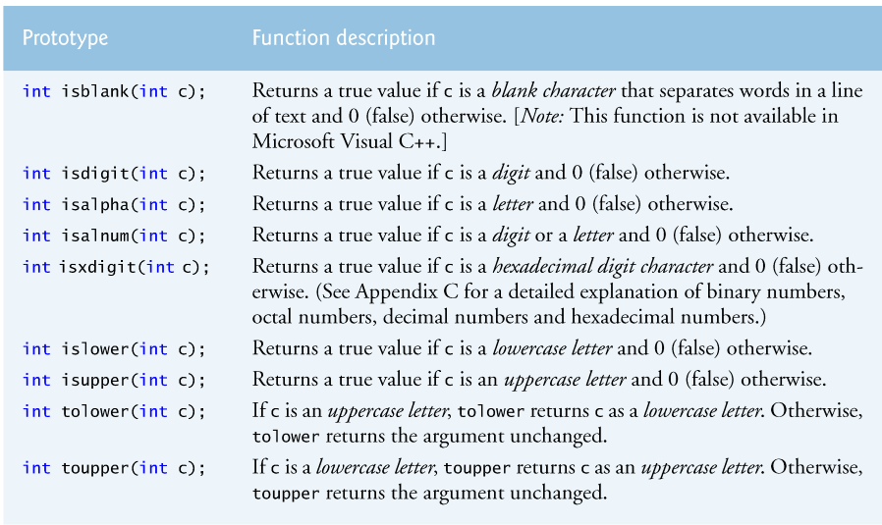
Character-Handling Library (cont.)
Notes:
- Explain and run C42_10_toupper.c.

Slide 11
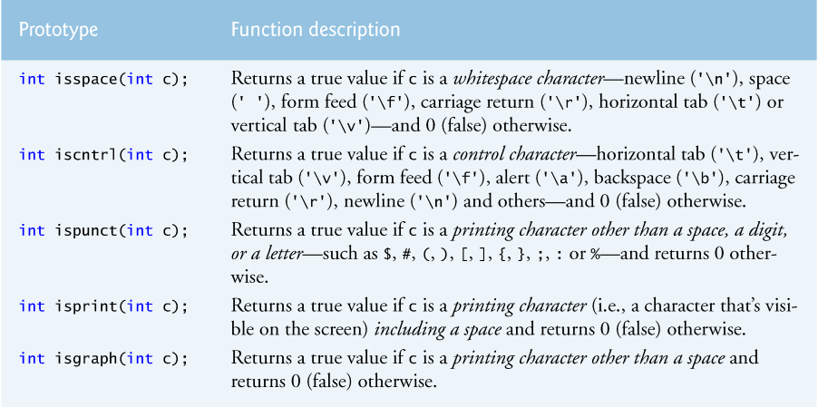
Character-Handling Library (cont.)

Slide 12
String Functions
There are multiple string functions that help programming. Learn what type of arguments are required and what they return.
Anything in double quotes is a string.
  You may access a string in double quotes.
You can find several string functions in string.h.
  strlen(), strcpy(), strcat(), strcmp()

Slide 13
String Lenght: strlen()
int strlen(char *st)
  Returns the length of its string parameter (excluding null character).
Example: Convert lowercase to uppercase
/* Convert lowercase to uppercase */
for (j=0; j<strlen(st); j++)
if (('a'<=st[j]) && (st[j]<='z'))
st[j] += 'A'-'a';
Notes:
- Explain and run C42_15_strlen.c.

Slide 14
String Copy: strcpy()
If you want to copy the contents of a string variable to another, simple assignment does not work !
  Example:
      char st1[5]="abcd", st2[5]="xyz";
      st1=st2;
    is wrong.
    You have to copy the characters one-by-one.
    There is a specific function that does this.
char *strcpy(char *dest, const char *source)
  Copies all characters in source into dest.
  Of course terminates dest with null char.
  Returns starting address of dest.
Notes:
- Explain and run C42_20_strcpy.c.

Slide 15
Example - strcpy()
  char st1[6]="abdef", st2[5]="xyz";
  strcpy(st1,st2);
  st1[2]='M';
  st2[3]='N';
  printf("<st1:%s>\n",st1);
  printf("<st2:%s>\n",st2);
  What is the output?
  <st1:xyM>
  <st2:xyzN>
Notes:
- Run C42_22_strcpy2.c, if required.

Slide 16
String Concatenation: strcat()
If you want to attach two strings, use strcat().
char *strcat(char *dest, char *source)
  Attaches source to the tail of dest.
  Chars in dest are not lost.
  Returns starting address of dest.

Slide 17
Example - strcat()
Write a function that reads a name from the input, prepends it with "Hello ", and updates its parameter to contain this greeting string. (You may assume the caller passes a parameter that is large enough.)
  void greet(char g_st[])
  { char name[20];
  scanf("%s", name);
  strcpy(g_st,"Hello ");
  strcat(g_st, name);
  }
Notes:
- Explain and run C42_25_strcat.c.

Slide 18
String Compare: strcmp()
You may also check if the lexicographical ordering of two strings.
int strcmp(const char *st1, const char *st2)
  Returns <0 if st1 comes before st2.
  Returns 0 if st1 is identical to st2.
  Returns >0 if st1 comes after st2.
Notes:
- Explain and run C42_30_strcmp.c.

Slide 19
Variants of String Functions
For string functions, you must ensure that the character array is large enough to store the string and its terminating null character.
  more data is stored in an array than its declared size causes
    a very dangerous condition
A solution is the use of safer functions: strncpy(), strncat(), strncmp()
  strncpy(dest,src,n)
    Copy at most n characters of src to dest.
  strncat(dest,src,n)
    Concatenate at most n characters of src to dest.
  strncmp(dest,src,n)
    Compare at most n characters of dest.

Slide 20
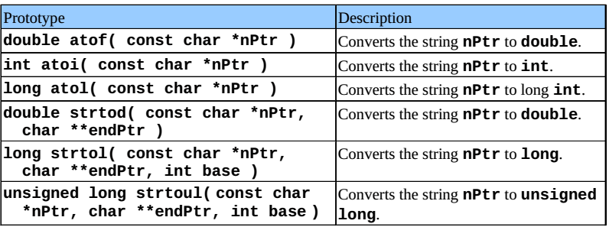
String-Conversion Functions
Conversion functions
  In <stdlib.h> (general utilities library)
  Convert strings of digits to integer and floatingpoint values

Slide 21
Double Pointer (Pointer to Pointer)
** → the pointer to store the address of another pointer
Example:
int **doublePtr;
int *ptr;
int var = 10;
ptr = &var;
doublePtr = &ptr;
printf("Value of var = %d\n", var ); // prints 10
printf("Value of var using single pointer = %d\n", *ptr); // prints 10
printf("Value of var using double pointer = %d\n", **doublePtr); // prints 10
doublePtr
ptr
val
0x4000
0x3000
0x3000
0x2000
0x2000
10

Slide 22
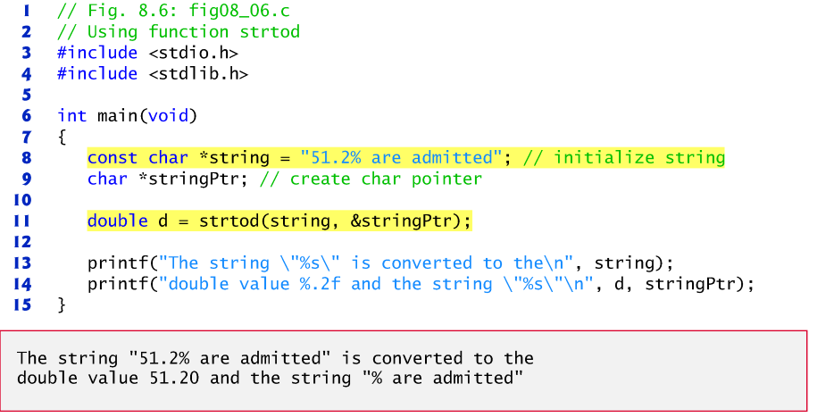
Example: fig08_06.c
Notes:
- Run C42_35_strtod.c, if required.

Slide 23
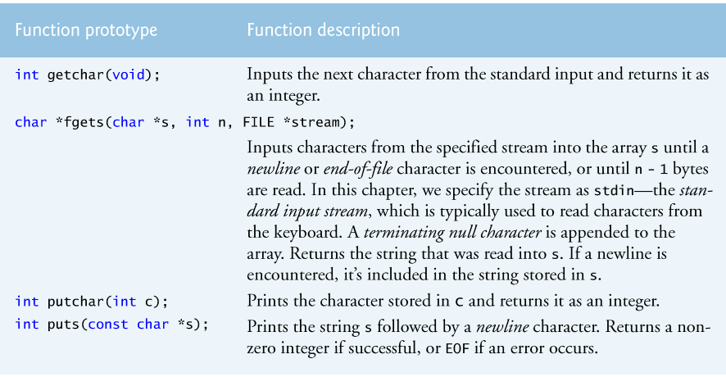
Standard Input/Output Library Functions
Functions in <stdio.h>
– Used to manipulate character and string data

Slide 24
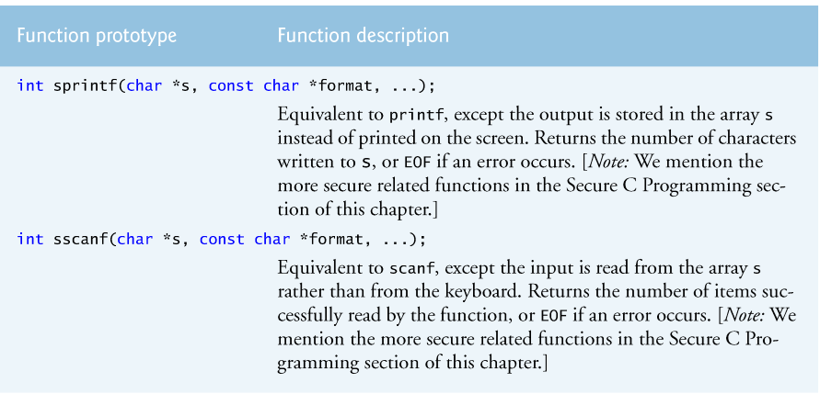
Standard Input/Output Library Functions (cont.)

Slide 25
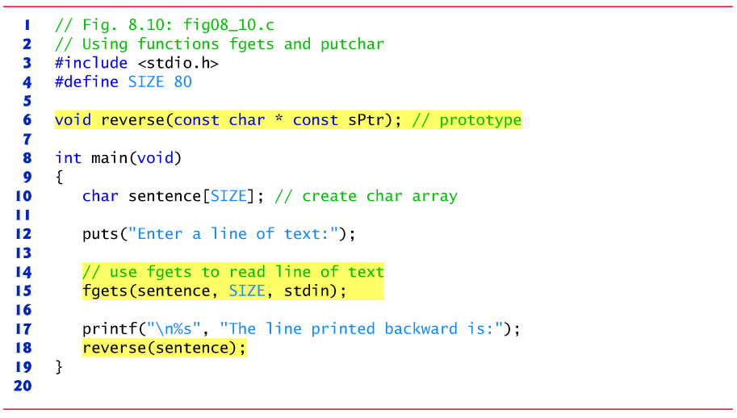
Example: fig08_10.c

Slide 26
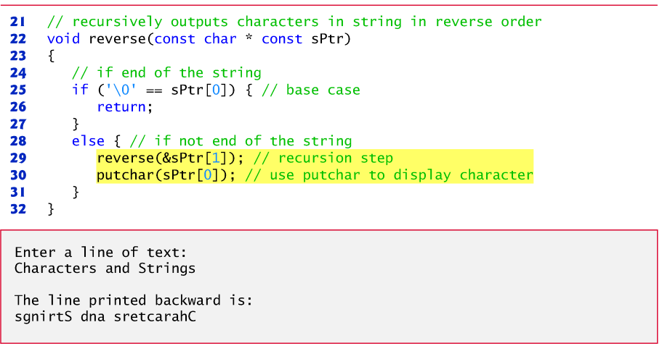
Example: fig08_10.c (cont.)
Notes:
- Explain and run C42_40_reverse.c.

Slide 27
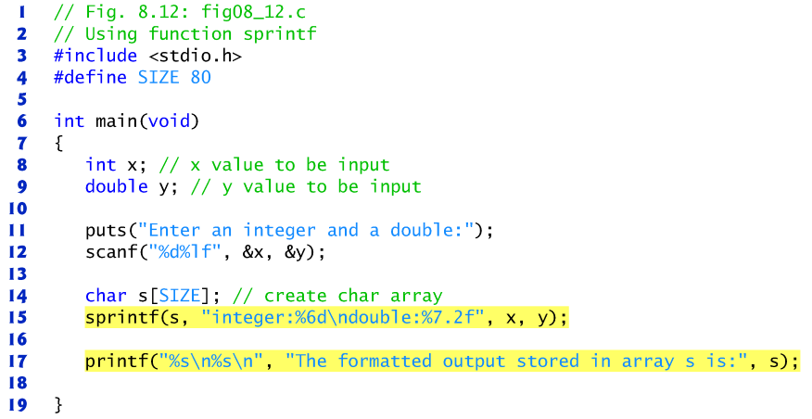
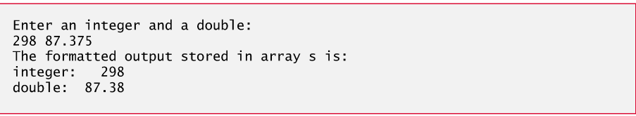
Example: fig08_12.c
Notes:
- Run C42_45_sprintf.c, if required.

Slide 28
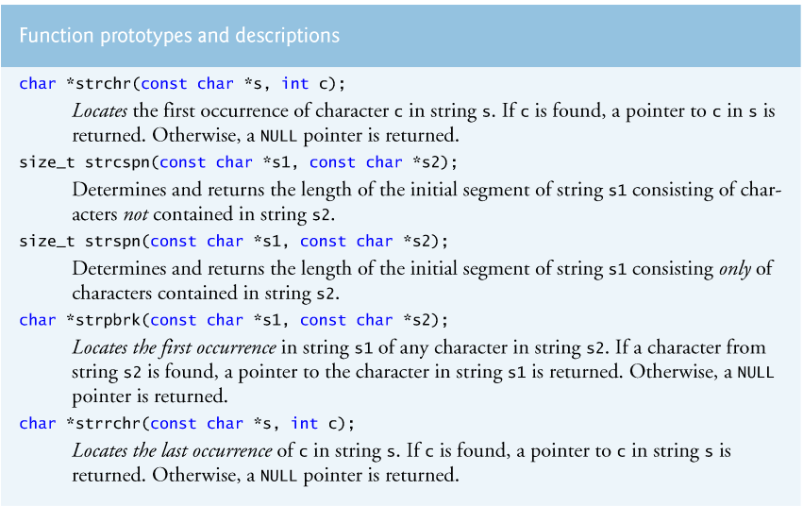
Search Functions of the String-Handling Library

Slide 29
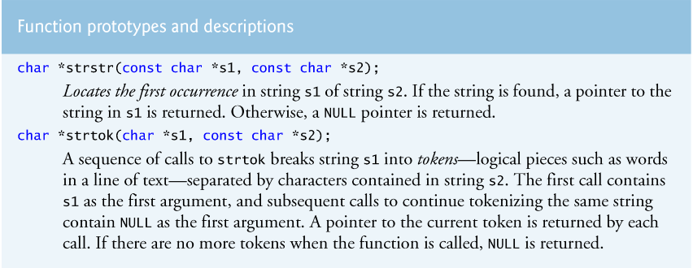
Search Functions of the String-Handling Library (cont.)

Slide 30
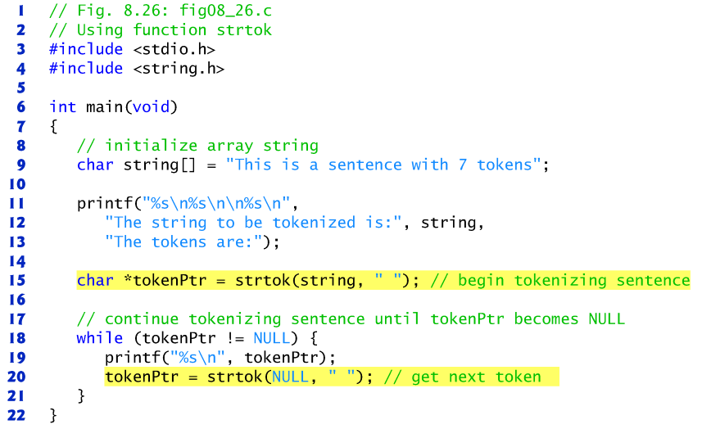
Example: fig08_26.c

Slide 31
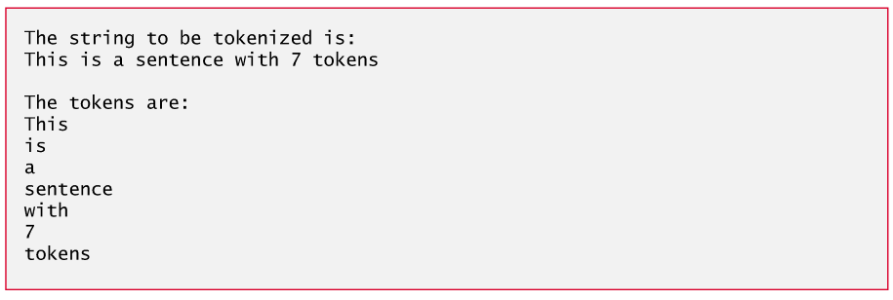
Example: fig08_26.c (cont.)
Notes:
- Run C42_50_strtok.c, if required.

Slide 32
Example - 1
Write a program that reads a string from the user.
Your program will detect whether the input string is a palindrome or not.
A palindrome is a character sequence which is symmetric. For example:
  abcddcba
  aaaappaaaa
  xyzyx
  ac bb ca
  ey edip adanada pide ye
Notes:
- Explain and run C42_55_palindrome.c.

Slide 33
Example - 2
Write a program which compresses the entered character sequence with the Run Length Encoding (RLE) algorithm.
RLE algorithm: It replaces sequences of the same data values (e.g.: characters, integers, etc.) by a count number and a single value.
EXAMPLE RUN:
INPUT:
aaaXXyyyyZ+++bb+++++77
OUTPUT:
3a2X4y1Z3+2b5+27
Notes:
- Run C42_60_RLE.c.
- Do not explain the program since it will be coded in lab sessions.

